Slide 1

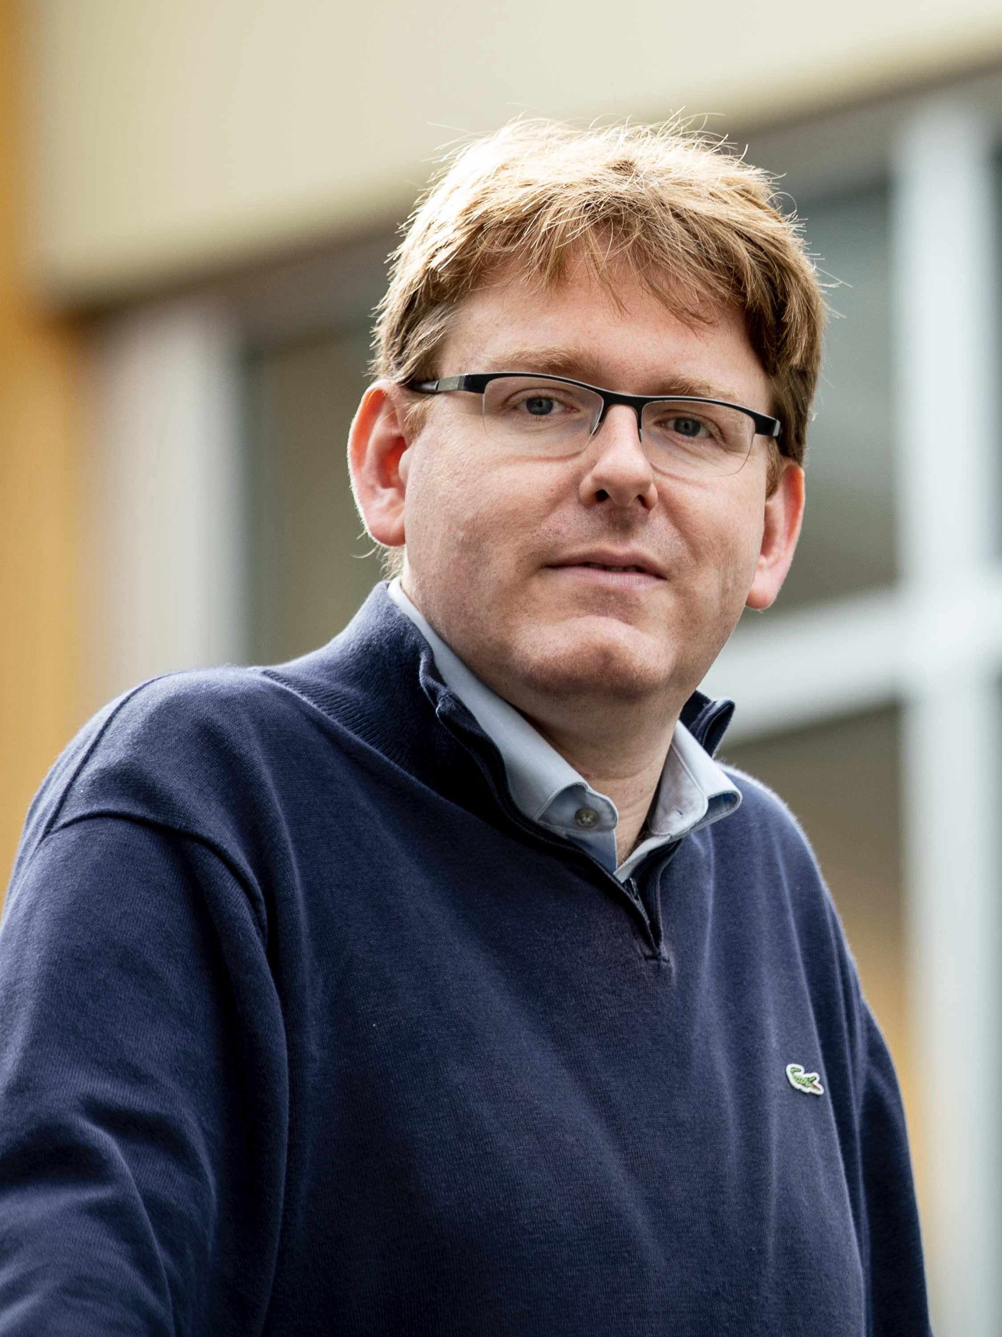
On the Concrete Security of BBS and BBS+ Signatures
Rutchathon (Champ) Chairattana-Apirom
Stefano Tessaro
ASIACRYPT’2025

Slide 2
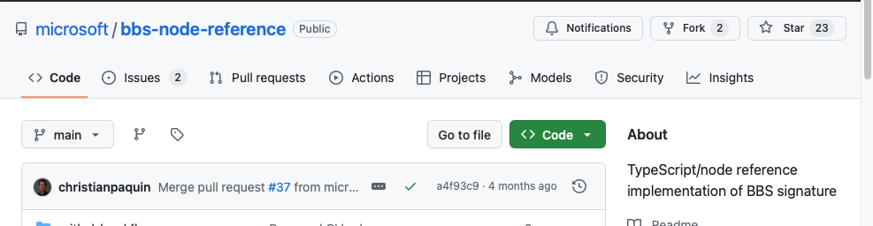
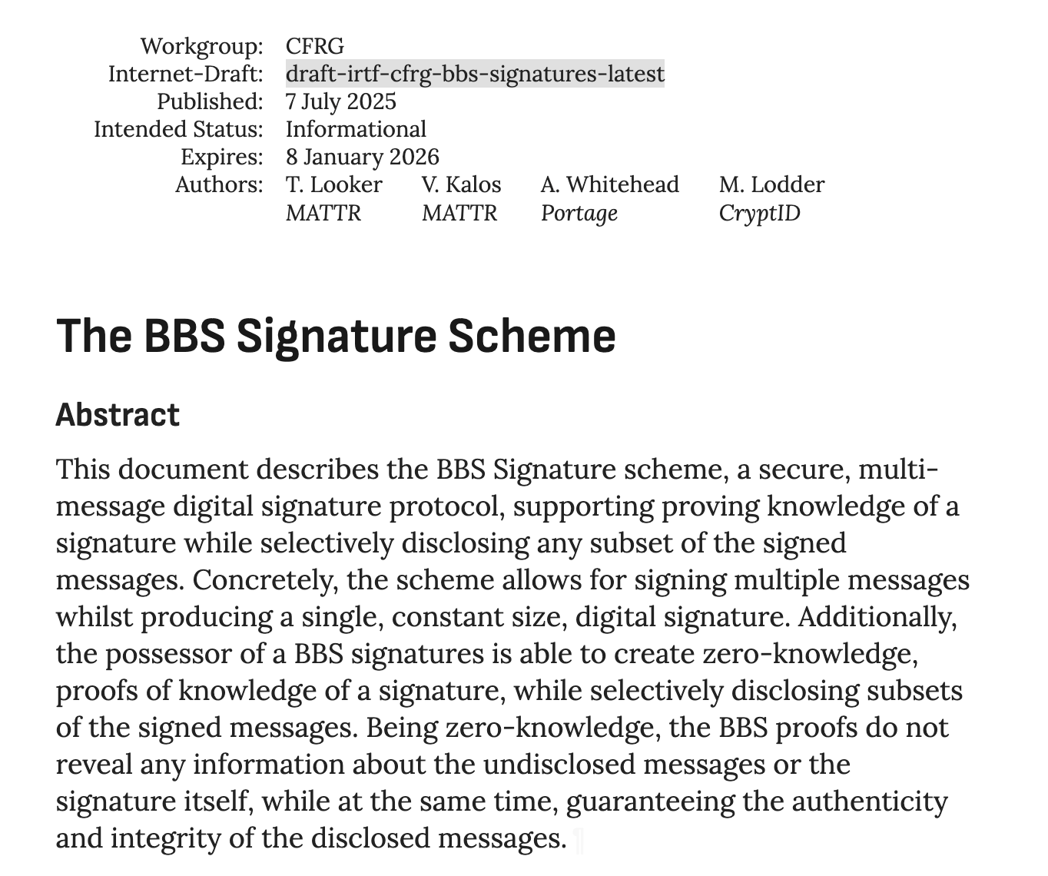
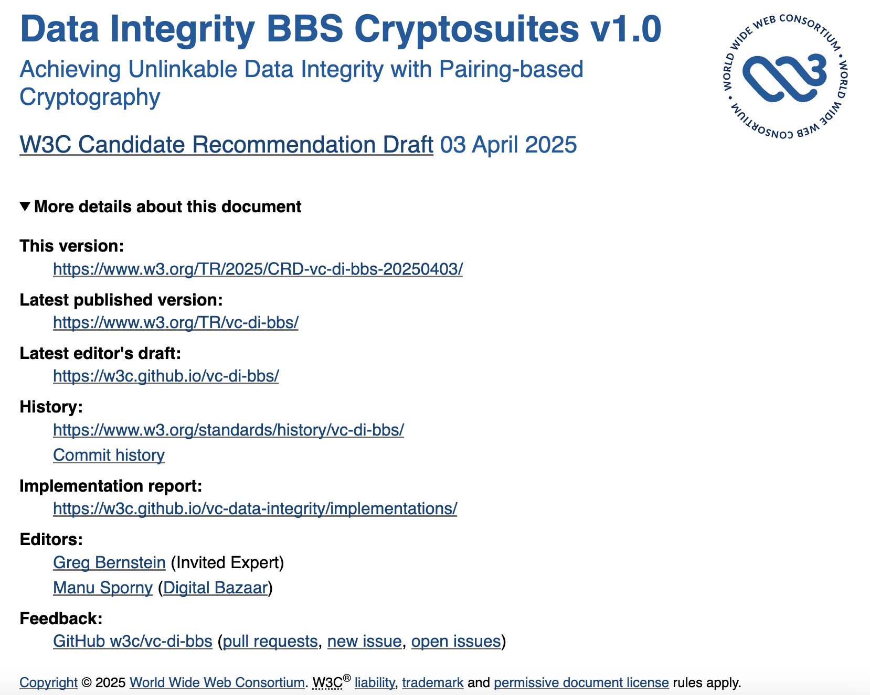
Motivation: Standardization
Recent interest in standardizing anonymous credentials with BBS signatures:
Decentralized identity foundation => IRTF draft
W3C’s verifiable credentials working group
Reference implementations by Microsoft and MATTR
Notes:
[45 sec]
Let’s first talk about why are we interested in BBS Signatures and/or its security.
First, there are recent renewed interests in deploying anonymous credentials that led to standardization efforts by:
Decentralized identity became an IRTF draft
W3C Verifiable credentials groups
Industry Reference implementations by microsoft and mattr

Slide 3

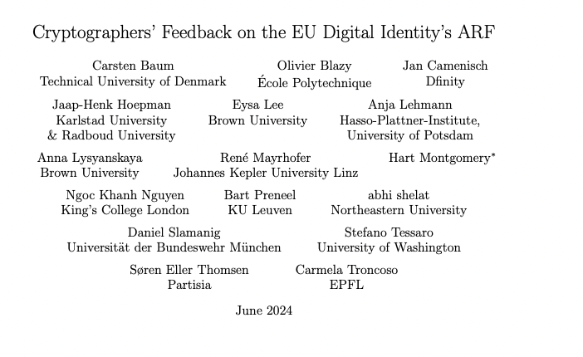
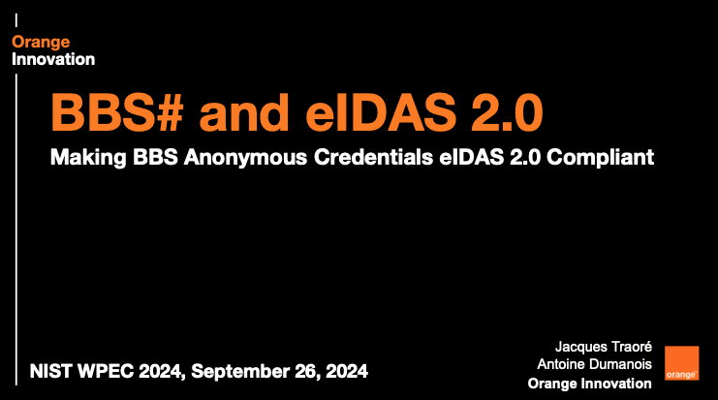
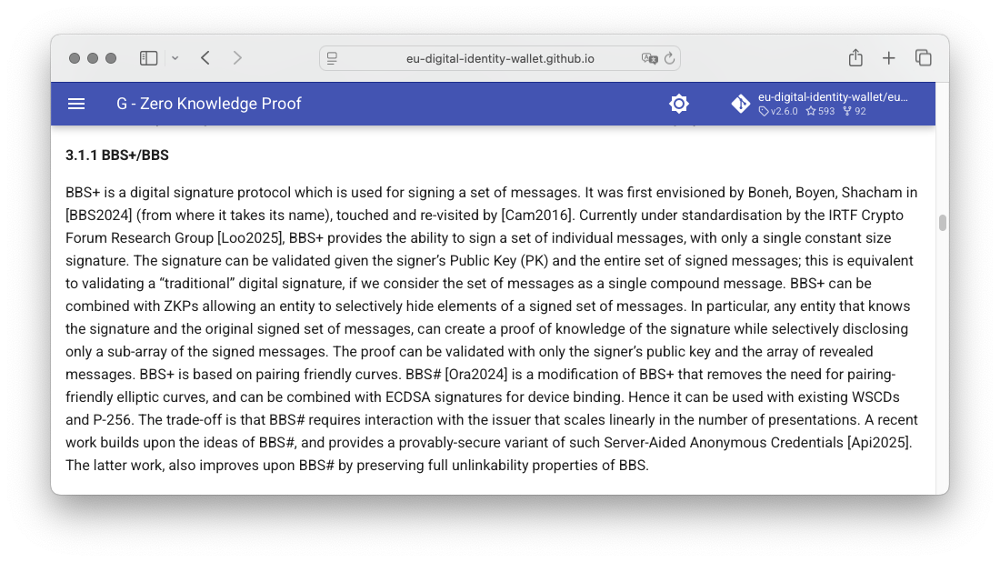
Motivation: EUDI
European Union Digital Identity Wallet
Cryptographer’s feedback recommending BBS
BBS# proposal by Orange
Notes:
[45 sec]
Also, in the EU, there is also a push for digital identity wallet by 2026.
In this context, anonymous credentials (with BBS) has been recommended by cryptographers as a possible options.
The company Orange also proposed a variant called BBS# with several properties such as device binding and a pairing-free solution.

Slide 4
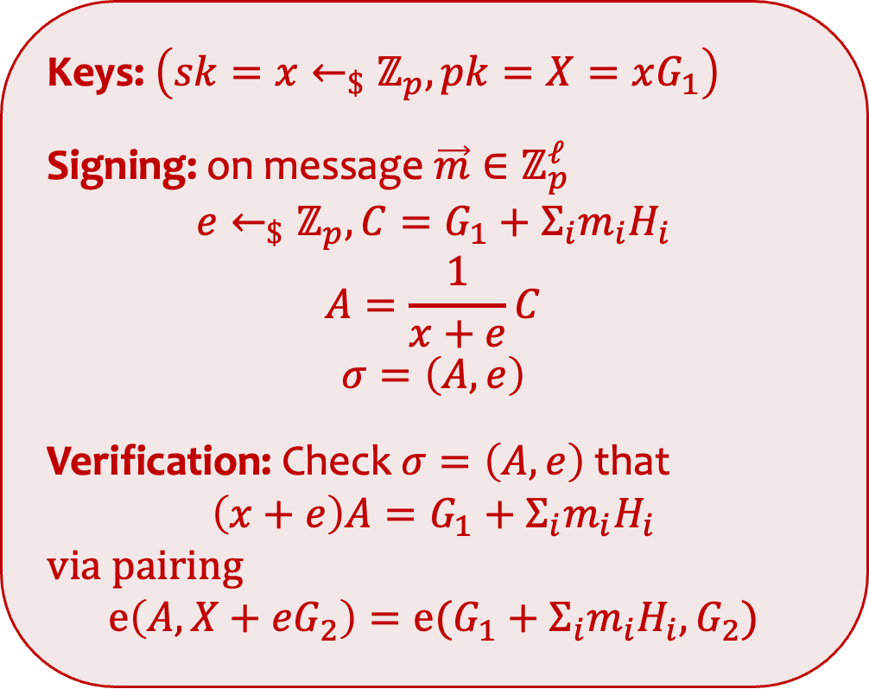
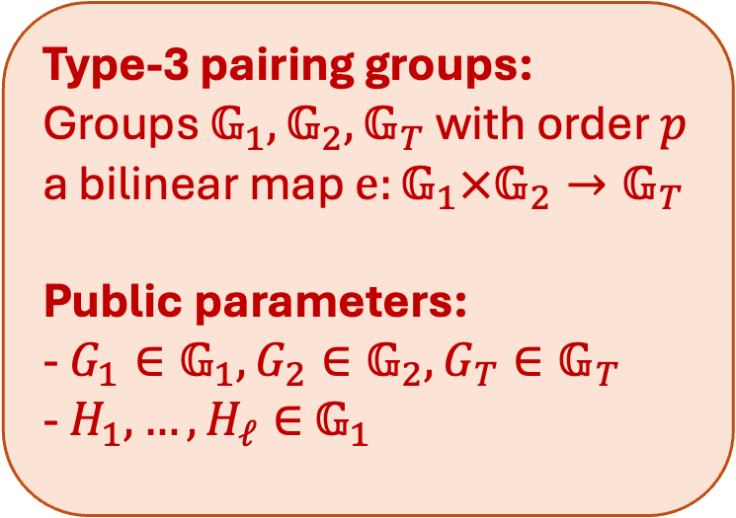
BBS Signatures
Keys: $\left(sk=x←_{\$}ℤ_{p}, pk=X=xG_{1}\right)$
Signing: on message $\vec{m}∈ℤ_{p}^{ℓ}$ $$e←_{\$}ℤ_{p},C=G_{1}+Σ_{i}m_{i}H_{i}$$
$$A=\frac{1}{x+e}C$$
$$σ=\left(A,e\right)$$
Verification: Check $σ=\left(A,e\right)$ that $$\left(x+e\right)A=G_{1}+Σ_{i}m_{i}H_{i}$$
via pairing $$e\left(A,X+eG_{2}\right)=e(G_{1}+Σ_{i}m_{i}H_{i},G_{2})$$
Type-3 pairing groups: Groups $𝔾_{1},𝔾_{2},𝔾_{T}$ with order $p$ a bilinear map $e:𝔾_{1}×𝔾_{2}→𝔾_{T}$
Public parameters: - $G_{1}∈𝔾_{1}, G_{2}∈𝔾_{2}, G_{T}∈𝔾_{T}$
- $H_{1},…,H_{ℓ}∈$ $𝔾_{1}$
Notes:
[3~ Minutes]
First, let me introduce BBS signatures.
For this talk, the scheme is defined in Type-3 pairing groups with the groups G1 G2 GT of prime order p and a bilinear map e.
The scheme is defined with public parameters containing random generators of these groups. Notably there is additionaly generator H1,…,Hl where l will be the length of our message.
For the scheme, we have the public and secret keys where … (read math)
The signing algorithm will sign messages m (a vector of scalars of length l) such that … (read math)
The verification simply checks that A and e is of the right format using the bilinear map e. Note that the x + e cancels out here.
Note that this verification equation has nice structures for efficient proof of knowledge of signatures.

Slide 5
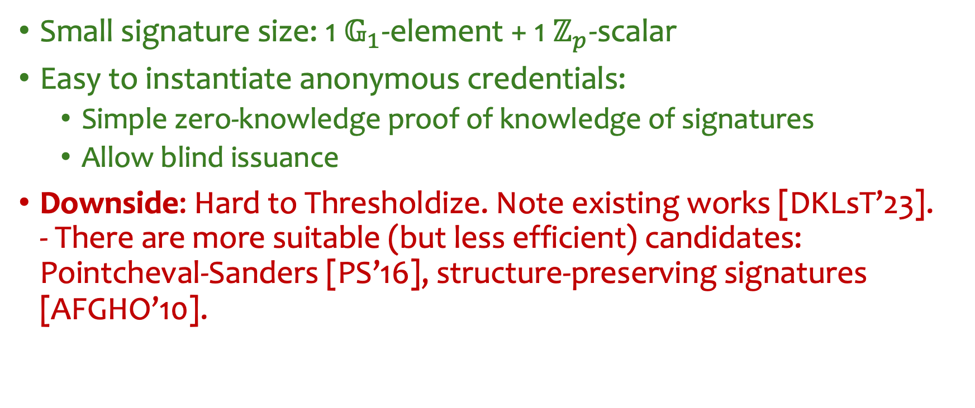
Why BBS?
Small signature size: 1 $𝔾_{1}$-element + 1 $ℤ_{p}$-scalar
Easy to instantiate anonymous credentials:
Simple zero-knowledge proof of knowledge of signatures
Allow blind issuance
Downside: Hard to Thresholdize. Note existing works [DKLsT’23]. - There are more suitable (but less efficient) candidates: Pointcheval-Sanders [PS’16], structure-preserving signatures [AFGHO’10].
Notes:
[1 minute]
Now, you might wonder why do we want to use BBS signatures?
First, the signature size is small.
Second the structure allows to easily instantiate anonymous credentials with simple proof of knowledge of signatures, and also the signing can be turned into a blind signing protocol.
In fact, there is also a draft for blind signing/issuance of BBS signatures on going as well.
However, there are also downsides as the scheme is hard to thresholdize. Although there are some efforts to do so, the threshold issuance protocol is quite inefficient compared to other algebraic signatures.

Slide 6
This Talk: Concrete security of BBS signatures via attacks, and the impact on security levels.
Notes:
[1 minute]
Motivated by the interests in the scheme. It is of course important for us to study the concrete security of the scheme. This is to set the security parameters correctly, And usually, they are set based on concrete security bounds from proofs or attacks
For this talk, we will discuss the concrete security of the scheme, both in terms of existing attacks and security proofs.

Slide 7
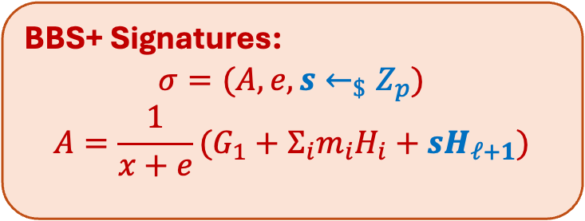
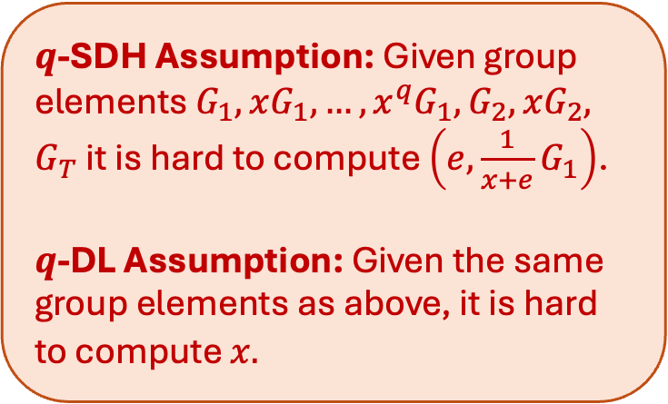
History of BBS Signatures
BBS+ Signatures:
$$σ=(A,e,s←_{\$}Z_{p})$$
$$A=\frac{1}{x+e}(G_{1}+Σ_{i}m_{i}H_{i}+sH_{ℓ+1})$$
2004: [Camenisch, Lysyanskaya ‘04] State the scheme without security proof
Inspired by a variant of [Boneh, Boyen, Shacham ’04] group signatures
2006: [Au, Susilo, Mu ‘06] Strong unforgeability proof of BBS+ from q-SDH assumption in Type-2 pairing groups
2012: [Hofheinz, Kiltz ‘12] EUF Security for BBS with bit-vector messages
2015: [Schäge ‘15] Tight proof of BBS+
2016: [Camenisch, Drijvers, Lehmann ’16] Adapted 2006 proof to Type-3 pairings
2023: [Tessaro, Zhu ‘23] Proof of the original BBS from q-SDH and a tight proof in the Algebraic Group Model (AGM) from q-DL.
Standardization effort transitioning to BBS instead
$q$-SDH Assumption: Given group elements $G_{1},xG_{1},…,x^{q}G_{1},G_{2},xG_{2},$ $G_{T}$ it is hard to compute $\left(e,\frac{1}{x+e}G_{1}\right)$.
$q$-DL Assumption: Given the same group elements as above, it is hard to compute $x.$
Notes:
Now that we know how the scheme looks like, let’s talk about what we have known so far about the security of the scheme.
The scheme was first stated by Camenisch and Lysyanskaya w/o a proof. It is inspired from a variant of the BBS group signatures by boneh, boyen, shacham.
In 2006, Au Susilo and Mu slightly modified the scheme (into what they call BBS+ signatures) and gave a proof in Type-2 pairing based on the q-SDH assumption.
[What is BBS+]
HK’12: Variant of BBS with bit-message but EUF security
Schage then later on gave a tight proof of the scheme.
CDL adapted the 2006 proof into type-3 pairings for more efficient scheme.
What is q-SDH and the variant q-DL
Then, recently Tessaro and Zhu gave a proof of the original BBS signatures in the standard model and with a tight proof in the AGM.
This led to the standardization transitioning to BBS because of the shorter signature size

Slide 8
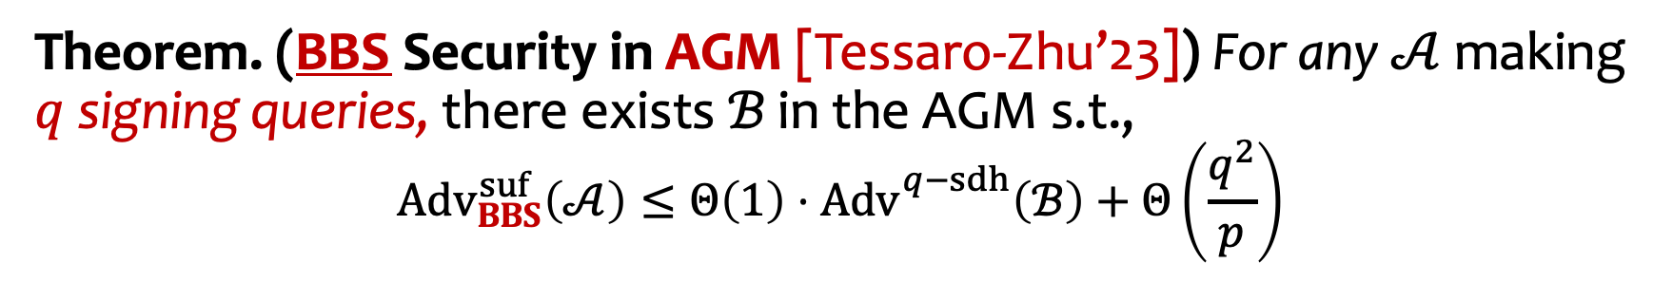
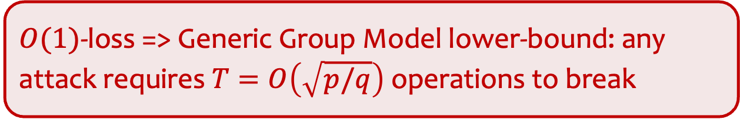
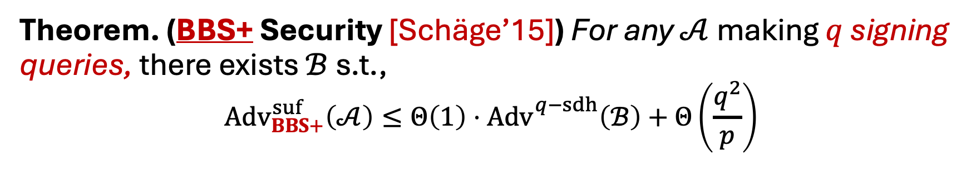
Concrete Security from Proofs
Theorem. (BBS+ Security [Schäge’15]) For any $𝒜$ making $q$ signing queries, there exists $ℬ$ s.t.,
$$Adv_{BBS+}^{suf}\left(𝒜\right)≤Θ\left(1\right)⋅Adv_{}^{q−sdh}\left(ℬ\right)+Θ\left(\frac{q^{2}}{p}\right)$$
Theorem. (BBS Security in AGM [Tessaro-Zhu’23]) For any $𝒜$ making $q$ signing queries, there exists ℬ in the AGM s.t.,
$$Adv_{BBS}^{suf}\left(𝒜\right)≤Θ\left(1\right)⋅Adv_{}^{q−sdh}\left(ℬ\right)+Θ\left(\frac{q^{2}}{p}\right)$$
$O(1)$-loss => Generic Group Model lower-bound: any attack requires $T=O\left(\sqrt{p/q}\right)$ operations to break
Notes:
Comments:
To summarize, here is what we currently know about the security of BBS and BBS+.
For BBS+, we have the tight proof by Sch\age. [Explain how to read the bounds, left the success prob of adversary’s breaking the scheme, right the reduction’s success probability in breaking hard problem]
Here, the proof is “tight” in that the reduction only lose constant factor in its success probability. What this implies is that the best attack will require at least sqrt{p/q} group operations to break the scheme.
This compared to the recent proof of BBS by Tessaro and Zhu in the standard model, where the reduction has O(q) loss (coming from a guessing argument) which is not tight. This results in a lower-bound of at least \sqrt{p}/q operations to break the scheme.
Note that this is factor sqrt{q} less operations needed. But still, because TZ’23 also gave a tight proof in the AGM which results in the same bound as BBS+, the security of these two should not be so far apart.

Slide 9
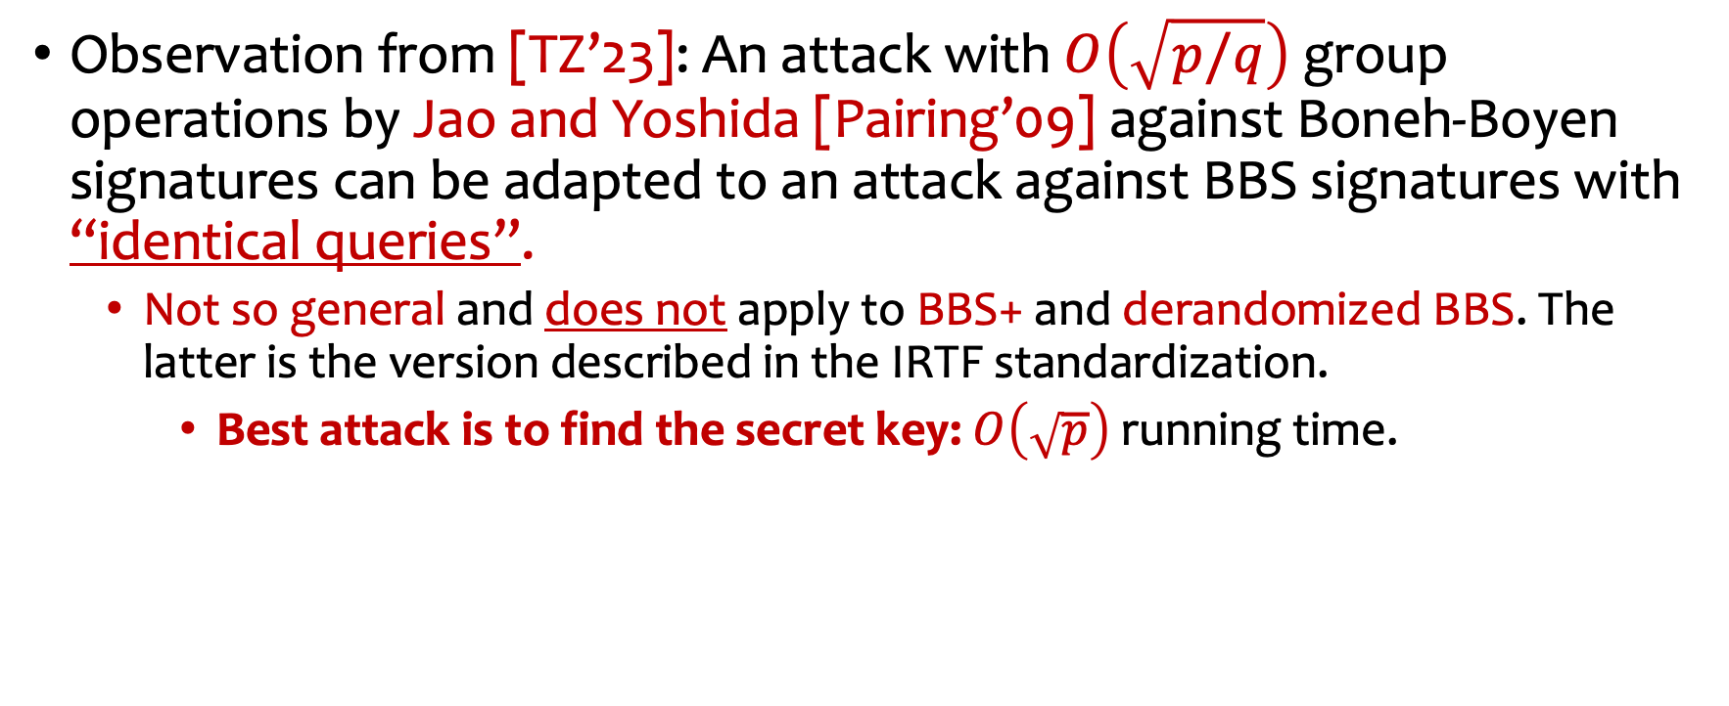
What about attacks?
Observation from [TZ’23]: An attack with $O\left(\sqrt{p/q}\right)$ group operations by Jao and Yoshida [Pairing’09] against Boneh-Boyen signatures can be adapted to an attack against BBS signatures with “identical queries”.
Not so general and does not apply to BBS+ and derandomized BBS. The latter is the version described in the IRTF standardization.
Best attack is to find the secret key: $O\left(\sqrt{p}\right)$ running time.
How the randomness e is computed in IRTF draft (Section 3.6.1.) https://www.ietf.org/archive/id/draft-irtf-cfrg-bbs-signatures-09.html
Notes:
With that said, it might not be the case that we have concrete attacks matching the guaranteed lower-bounds by the security proofs.
One observation by TZ’23 is that an attack by Jao and Yoshida against Boneh-Boyen signatures can be adapted to BBS signatures with a caveat that the attack has to make signing queries on the same message. This limitation however does not apply to BBS+ or derandomized version of BBS. This is simply because each signature in BBS+ will contain distinct random scalar s, and for derandomized BBS signatures of the same message will result in the same signature. This derandomized BBS is the version described in the IRTF draft.

Slide 10
Summary of BBS Concrete Security (so far)
Randomized BBS
[TZ’23] Standard model proof
[TZ’23] AGM proof
[JY’09] Attack
Key recovery attack
Derandomized BBS
Better attacks??
BBS+ (Randomized and derandomized)
[ASM’06,CDL’16] proof
[Schäge’15] proof
$$T$$
$O\left(\sqrt{p}/q\right)$
$$O\left(\sqrt{p/q}\right)$$
$$O\left(\sqrt{p}\right)$$
Notes:
With that said, this is what the landscape looks like for the security guarantees categorized by the generic group upper/lower-bounds.
On the proof side, we have the non-tight proof and tight proof for BBS+ and the recent non-tight proof for BBS.
On the attack side, we have the naïve key-recovery attack which breaks dlog, and the more sophisticated attack by Jao-Yoshida which improves by \sqrt{q} factor. As you can see, there are some key open questions/concerns over the concrete security of BBS.
We wonder whether there is a better attack on BBS+ or derandomized BBS that matches the attack for .
(This is more theoretically motivated, but) we wonder if we can also give a tight proof of BBS in the standard model?
These are motivated by some concerns that BBS+ maybe more secure than BBS in some cases.

Slide 11

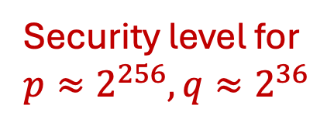
This work
Bottom-line: BBS and BBS+ have roughly the same concrete security
Note: $p≈2^{256}$ is the group size of BLS12-381 curve in IRTF draft
Randomized BBS
[TZ’23] Standard model proof
[TZ’23] AGM proof
[JY’09] Attack
Key recovery attack
Derandomized BBS
Yes (This talk)
BBS+ (Randomized and derandomized)
[ASM’06,CDL’16] proof
[Schäge’15] proof
$$T$$
$O\left(\sqrt{p}/q\right)$
$$O\left(\sqrt{p/q}\right)$$
$$O\left(\sqrt{p}\right)$$
Security level for $p≈2^{256},q≈2^{36}$
~92 bits
~110 bits
~128 bits
Notes:
Our results, however, shows that the answers to both of these are YES, with some caveat on the second.

Slide 12
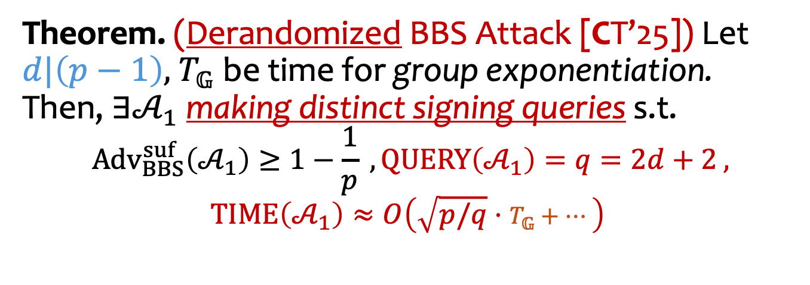
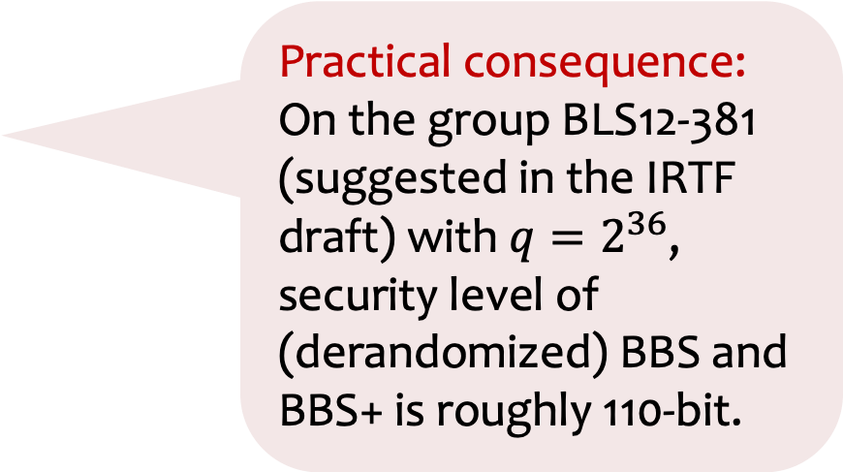
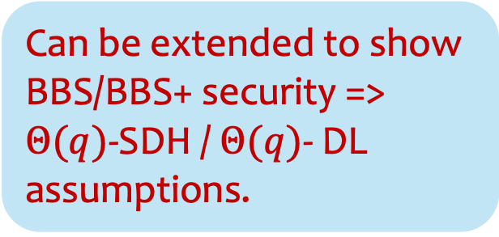
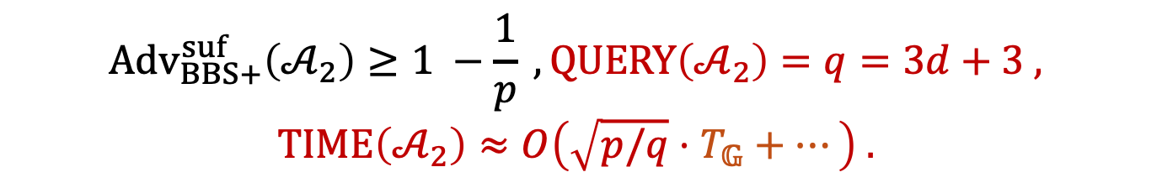
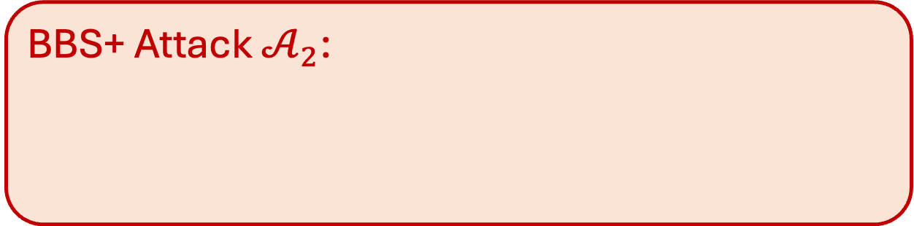
Our Results: Concrete Attacks
Can be extended to show BBS/BBS+ security => $Θ(q)$-SDH / $Θ(q)$- DL assumptions.
Theorem. (Derandomized BBS Attack [CT’25]) Let $d|\left(p−1\right),$ $T_{𝔾}$be time for group exponentiation. Then, $∃𝒜_{1}$ making distinct signing queries s.t.
$$Adv_{BBS}^{suf}\left(𝒜_{1}\right)≥1−\frac{1}{p} , QUERY\left(𝒜_{1}\right)=q=2d+2 ,$$
$$TIME\left(𝒜_{1}\right)≈O\left(\sqrt{p/q}⋅T_{𝔾}+…\right)$$
Practical consequence: On the group BLS12-381 (suggested in the IRTF draft) with $q=2^{36}$, security level of (derandomized) BBS and BBS+ is roughly 110-bit.
BBS+ Attack $𝒜_{2}$:
$$Adv_{BBS+}^{suf}\left(𝒜_{2}\right)≥1 −\frac{1}{p} , QUERY\left(𝒜_{2}\right)=q=3d+3 ,$$
$$TIME\left(𝒜_{2}\right)≈O\left(\sqrt{p/q}⋅T_{𝔾}+…\right) .$$
Notes:
To go into more details: Here is our first attack. We rely on a divisor d of p-1.
Also explain slight distinctions between BBS and BBS+ bounds (the query count).

Slide 13



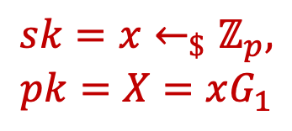
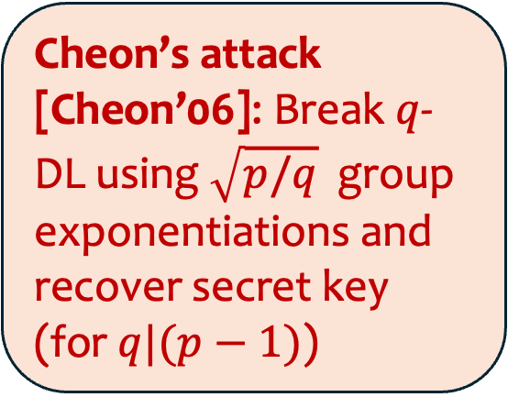


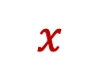

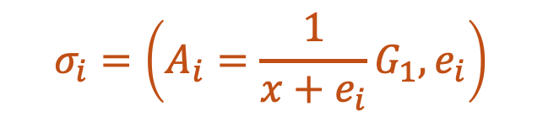

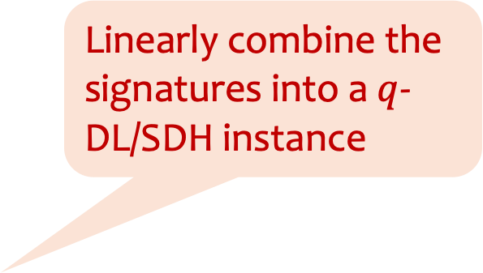
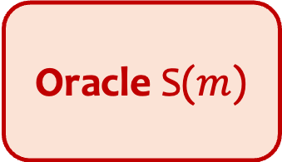

Starting Point: Jao and Yoshida attack [JY’09]
Adversary $𝒜$
Linearly combine the signatures into a $q$-DL/SDH instance
$$sk=x←_{\$}ℤ_{p},$$
$$pk=X=xG_{1}$$
$$pk=X$$
$$m_{i}=0$$
Oracle S($m$)
Cheon’s attack [Cheon’06]: Break $q$-DL using $\sqrt{p/q}$ group exponentiations and recover secret key (for $q|(p−1)$)
$$σ_{i}=\left(A_{i}=\frac{1}{x+e_{i}}G_{1},e_{i}\right)$$
$${G’}_{},x{G’}_{},…,x^{q}{G’}_{}$$
$$x$$
Can now forge with $x$
Notes:
Go step by step here.
Adversary makes identical queries on 0.
Signatures contains e_i which are random
The key idea of the attack is to linearly combine the A_i’s into a q-DL instance, i.e., the elements with power of x.
Finally, they apply Cheon’s attack which breaks q-DL using roughly sqrt{p/q} exponentiations. Note: attack works for specific values of q

Slide 14


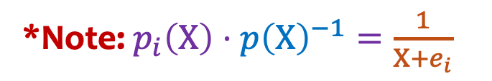
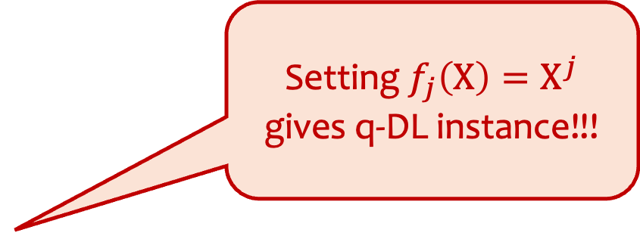
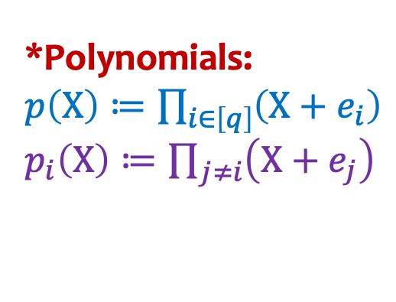
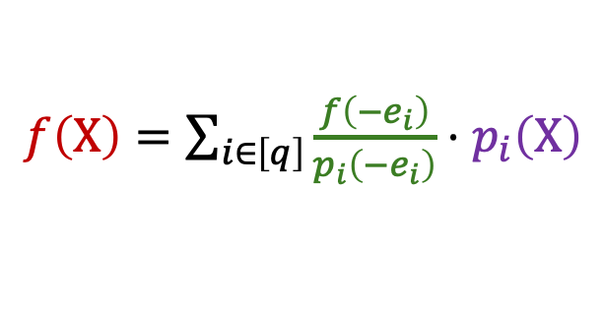
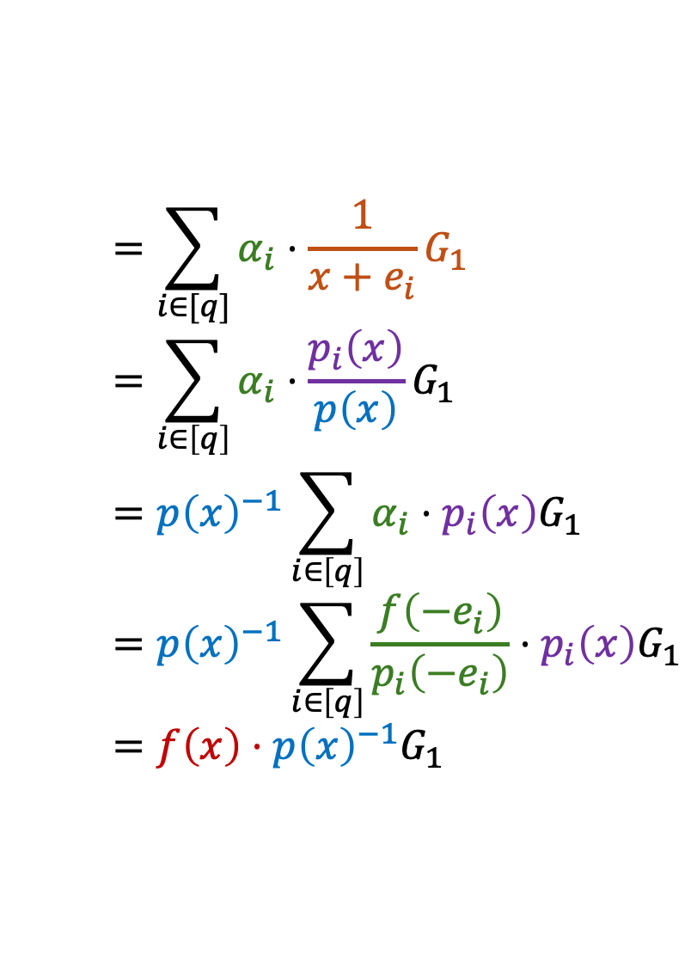
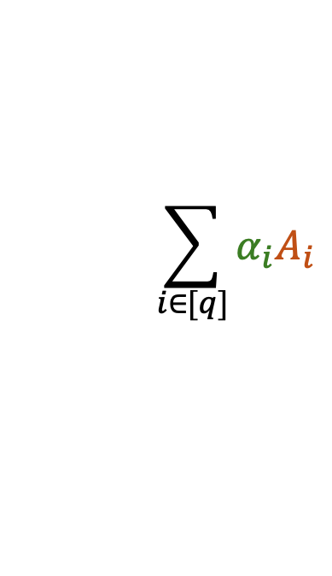
Jao and Yoshida attack on BBS [JY’09]
Linearly combine $A_{i}$ with coefficients $α_{i}∈ℤ_{p}$
*Polynomials:
$p\left(X\right)≔\prod_{i∈\left[q\right]}{\left(X+e_{i}\right)}$
$p_{i}\left(X\right)≔\prod_{j≠i}{\left(X+e_{j}\right)}$
$$\sum_{i∈[q]}{α_{i}A_{i}}$$
$$=\sum_{i∈[q]}{α_{i}⋅\frac{1}{x+e_{i}}G_{1}}$$
$$=\sum_{i∈\left[q\right]}{α_{i}⋅\frac{p_{i}\left(x\right)}{p\left(x\right)}G_{1}}$$
$$=p{\left(x\right)}^{−1}\sum_{i∈\left[q\right]}{α_{i}⋅p_{i}\left(x\right)G_{1}}$$
$$=p{\left(x\right)}^{−1}\sum_{i∈\left[q\right]}{\frac{f\left(−e_{i}\right)}{p_{i}\left(−e_{i}\right)}⋅p_{i}\left(x\right)G_{1}}$$
$$=f\left(x\right)⋅p{\left(x\right)}^{−1}G_{1}$$
*Note: $p_{i}\left(X\right)⋅p{\left(X\right)}^{−1}=\frac{1}{X+e_{i}}$
Pick $α_{i}=\frac{f\left(−e_{i}\right)}{p_{i}\left(−e_{i}\right)}$
Setting $f_{j}\left(X\right)=X^{j}$ gives q-DL instance!!!
Lagrange basis polynomials
$f\left(X\right)=\sum_{i∈\left[q\right]}{\frac{f\left(−e_{i}\right)}{p_{i}\left(−e_{i}\right)}⋅p_{i}\left(X\right)}$
Notes:
Now, let me show you how Step 1 works:
Say we linearly combine with arbitrary coefficients alpha_i. Now I expand each A_i out.
Then, the next step is to observe that we can rewrite this with a bunch of polynomials.
In particular, we define p(X) as the product of (X + e_i) and p_i(X) as product of all (X+e) except e_i.
The next step is to convert this right hand side to some power of x.

Slide 15
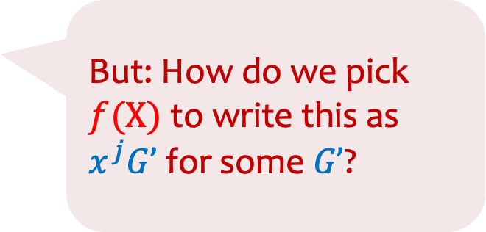
Our Approach: Attempt to apply [JY’09] idea
$p\left(X\right)≔\prod_{i∈\left[q\right]}{\left(X+e_{i}\right)}$ $p_{i}\left(X\right)≔\prod_{j≠i}{\left(X+e_{j}\right)}$
$α_{i}=\frac{f\left(−e_{i}\right)}{p_{i}\left(−e_{i}\right)}$
$$\sum_{i∈[q]}{α_{i}A_{i}}$$
$$=\sum_{i∈[q]}{α_{i}⋅\frac{1}{x+e_{i}}(G_{1}+m_{i}H_{1})}$$
$$=p{\left(x\right)}^{−1}\sum_{i∈\left[q\right]}{α_{i}⋅p_{i}\left(x\right)G_{1}}$$
$$=f\left(x\right)p{\left(x\right)}^{−1}G_{1}$$
$$+p{\left(x\right)}^{−1}\sum_{i∈\left[q\right]}{α_{i}m_{i}⋅p_{i}\left(x\right)H_{1}}$$
Lagrange basis polynomials
But: How do we pick $f(X)$to write this as $x^{j}G’$ for some $G’$?
$$+g\left(x\right)p{\left(x\right)}^{−1}H_{1}$$
Polynomials $f\left(X\right),$ $g\left(X\right)$ has degree $<q$ and satisfy:
$$∀i∈\left[q\right]:g\left(−e_{i}\right)=m_{i}⋅f\left(−e_{i}\right)$$
Notes:
What if we try to apply the same strategy and let’s expand things further?
We first expand A_i
Then, repeating similar steps we write things in terms of linear combinations of p_i(x). The first part is similar to before, but the second part is what makes things difficult as the coefficients are not the same (we get \alph_i * m_i instead).
Going a bit further, we can write this as polynomials evaluated on x using lagrange basis. Here, you have two polynomials f and g with some constraints: namely, the degrees are bounded and evaluations at –e_i of g is f(e_i) scaled by m_i.
Now, the problem is reducted to whether we can use this structure to construct our q-DL instance

Slide 16
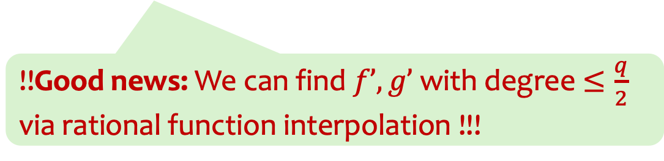

Our Key Observation
If we select $f\left(X\right)=X^{j}$ $f’\left(X\right)$ and $g\left(X\right)=X^{j}g’\left(X\right)$, then
$$f\left(x\right)p{\left(x\right)}^{−1}G_{1}+g\left(x\right)p{\left(x\right)}^{−1}H_{1}=x^{j}⋅\underbrace{p{\left(x\right)}^{−1}\left(f’\left(x\right)G_{1}+g’\left(x\right)H_{1}\right)}$$
$$G’$$
Hence, we want $f’\left(X\right),g’\left(X\right)$ with degrees $Θ\left(q\right)$ such that $$∀i∈\left[q\right]:g’\left(−e_{i}\right)=m_{i}⋅f’\left(−e_{i}\right)$$ so that we can construct these elements for $j=0…Θ\left(q\right)$.
!!Good news: We can find $f’, g’$ with degree $≤\frac{q}{2}$ via rational function interpolation !!!
Notes:
Don’t explain why rational function interpolation works here. (only if. asked)

Slide 17
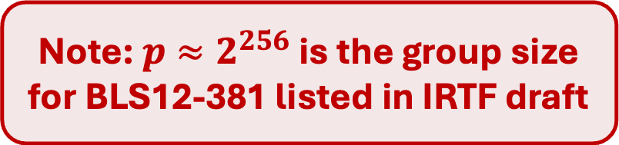
Summary
Bottom-line: BBS and BBS+ have roughly the same concrete security
Note: $p≈2^{256}$ is the group size for BLS12-381 listed in IRTF draft
Randomized BBS
[TZ’23] Standard model proof
[TZ’23] AGM proof
[JY’09] Attack
Key recovery attack
Derandomized BBS
THIS WORK
BBS+ (Randomized and derandomized)
[ASM’06,CDL’16] proof
[Schäge’15] proof
$$T$$
$O\left(\sqrt{p}/q\right)$
$$O\left(\sqrt{p/q}\right)$$
$$O\left(\sqrt{p}\right)$$
Security level for $p≈2^{256},q≈2^{36}$
~92 bits
~110 bits
~128 bits
Notes:
Our results, however, shows that the answers to both of these are YES, with some caveat on the second.

Slide 18
Future Directions
Tight Standard Model Proofs [CHT’25,ePrint:2025/1973]
Can we apply this type of improved attack anywhere else?
Non-generic attacks?
Other applications & extensions to BBS-based credentials
Thank you! Please check out ePrint:2025/1093

